Slide 1
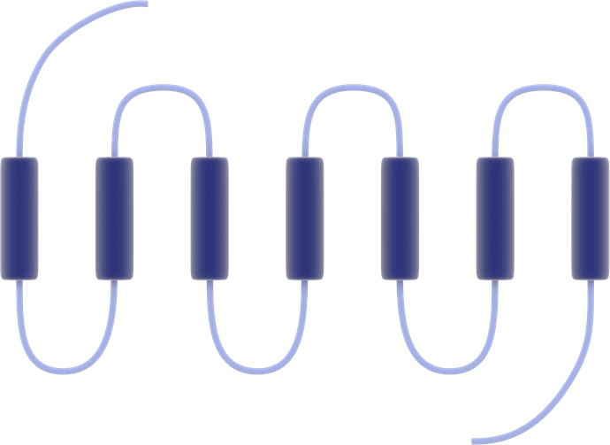
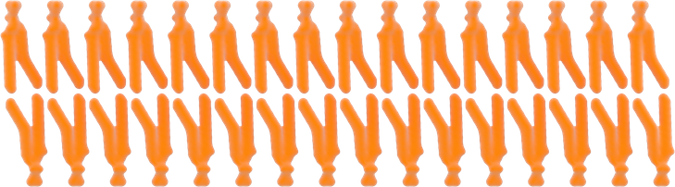
Seven-transmembrane receptor
NH₂
Extracellular
Intracellular
COOH

